Slide 1


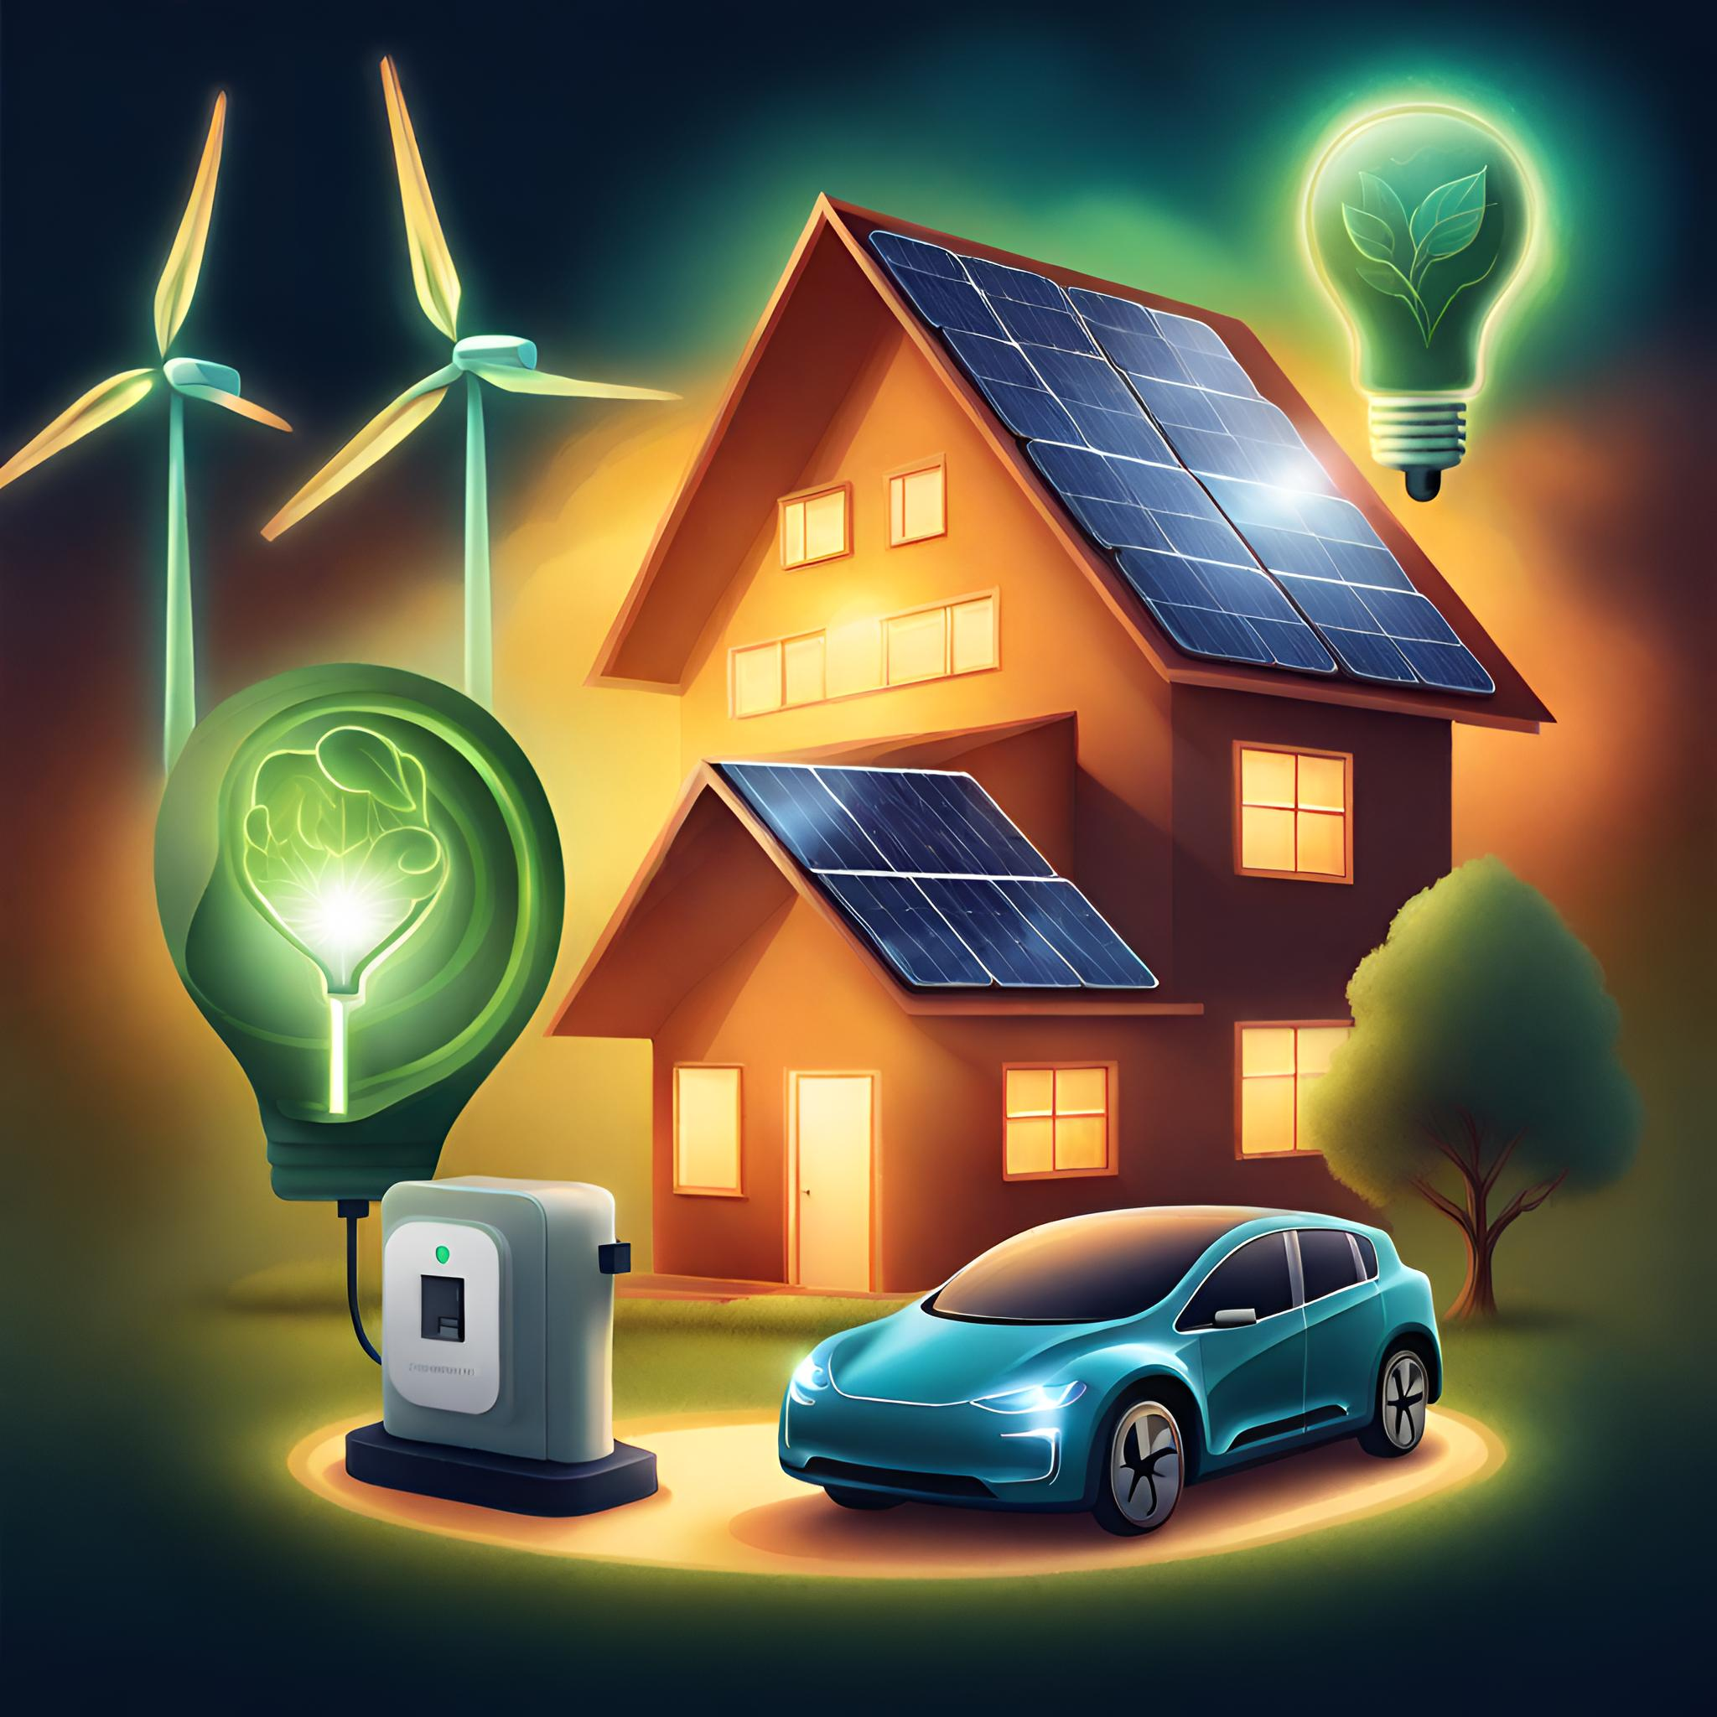
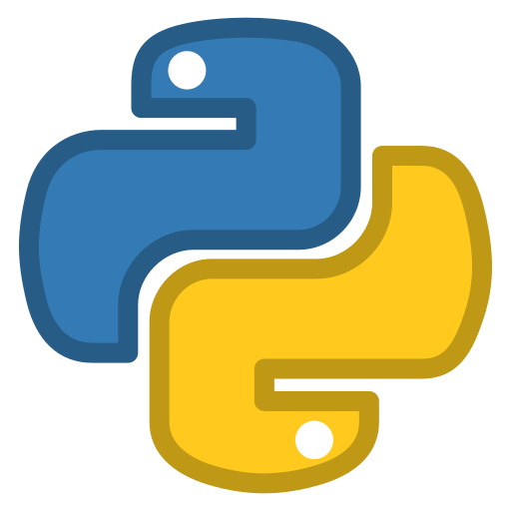
Python Refresher for Sustainable Energy Management Module
Generated by AI with Canva

Slide 2


Generated by AI with Canva
Workshop Outline
Introduction to Python
Python in the Sustainable Energy Industry
Getting Started with Python
Python Basics
Python Installation
Jupyter Notebook Installation
What is Python
Why Python for Sustainable Energy Management?
On an NTU Laptop
On your Own Laptop
Python Learning Resources
Python Refresher for Sustainable Energy Management Module

Slide 3

ENGG40341 Page on NOW Learning room:
All the news, required information, and related files related to the module will be posted on the NOW learning room of this module (https://now.ntu.ac.uk/). Please check it regularly.
Python Refresher for Sustainable Energy Management Module
3

Slide 4
Introduction to Python
🐍What is Python:
High-level, general-purpose programming language.
Created by Guido van Rossum and first released in 1991.
Emphasizes readability and ease of use.
✔️Key Features:
Interpreted language: No need for compilation.
Dynamically typed: Variable types are assigned at runtime.
Object-oriented: Supports object-oriented programming principles.
Versatile: Used for optimisation, data visualization, web development, data analysis, artificial intelligence, automation, and more.
⚖️Syntax:
Easy to read, with clear and expressive syntax.
Uses indentation (whitespace) for code blocks, eliminating the need for braces{}.
Python Refresher for Sustainable Energy Management Module
4

Slide 5
Introduction to Python
Why Python for Sustainable Energy Management?
📖Readability and Ease of Learning:
Python's clear and readable syntax makes it accessible to beginners and experts.
This is particularly beneficial in the energy sector, where professionals may have diverse backgrounds.
🧑‍🏭Rapid Prototyping and Development:
Python allows for quick development of prototypes and applications, which is essential for the dynamic and evolving field of sustainable energy management.
This rapid prototyping capability accelerates the testing and implementation of new ideas and solutions.
📑Extensive Libraries and Frameworks:
Python has a rich ecosystem of libraries and frameworks that support various aspects of sustainable energy management.
Libraries like Pandas and NumPy are valuable for data analysis and manipulation, while libraries like TensorFlow and PyTorch are essential for machine learning applications in energy forecasting.
Generated by AI with Canva
Python Refresher for Sustainable Energy Management Module
5

Slide 6

Introduction to Python
Why Python for Sustainable Energy Management?
Generated by AI with Canva
📈Data Analysis and Visualization:
Python is widely used for data analysis, an integral part of energy management.
Libraries such as Matplotlib and Seaborn facilitate the visualization of energy consumption patterns, enabling better decision-making.
🏭Interoperability and Integration:
Python can seamlessly integrate with existing systems and technologies, fostering interoperability.
This is crucial in the energy sector, where diverse systems (e.g., IoT devices, sensors, SCADA systems) need to work together for effective energy management.
📉Machine Learning for Energy Forecasting:
Python's popularity in the machine learning community, coupled with powerful libraries like scikit-learn, enables the development of models for energy consumption forecasting.
Machine learning algorithms can help optimize energy usage, improve efficiency, and contribute to sustainability goals.
Python Refresher for Sustainable Energy Management Module
6

Slide 7

Introduction to Python
Why Python for Sustainable Energy Management?
Generated by AI with Canva
🤝Community Support and Collaboration:
Python has a large and active community that contributes to the development of tools and solutions for various domains, including sustainable energy.
The availability of open-source projects and collaborative platforms fosters knowledge sharing and innovation.
💻Flexibility and Scalability:
Python's flexibility allows for the development of scalable applications that can adapt to the changing needs of sustainable energy management.
It can be used for small-scale projects as well as large, enterprise-level applications.
⚡Remote Monitoring and Control:
Python supports the development of applications for remote monitoring and control of energy systems.
This is essential for managing distributed energy resources and ensuring efficient energy usage across various locations.
Python Refresher for Sustainable Energy Management Module
7

Slide 8





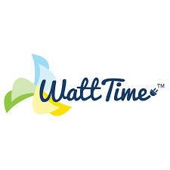


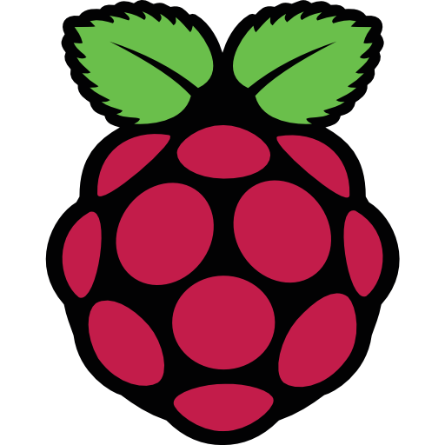
Introduction to Python
Python in the Sustainable Energy Applications
Generated by AI with Canva
Python Refresher for Sustainable Energy Management Module
8

Slide 9
Introduction to Python
Python in the Sustainable Energy Applications
Open Energy Data Initiative (OEDI):
OEDI aims to provide access to a wide range of energy-related datasets. Python is often used for data analysis and visualization within this initiative.
Emoncms:
Emoncms is an open-source energy monitoring platform. Python is often used for data analysis and visualization in projects that involve Emoncms.
WattTime:
WattTime is a nonprofit that provides software tools for measuring the environmental impact of electricity use. Python is used for data analysis and developing algorithms to determine the carbon intensity of electricity.
EnergyHub:
EnergyHub uses Python for its platform that enables utilities to manage distributed energy resources (DERs). Python is employed for data processing, analysis, and optimization.
PVlib Python:
PVlib Python is a library for modeling solar energy generation. It provides tools for simulating the performance of photovoltaic systems, and it's widely used in the renewable energy sector.
Python Refresher for Sustainable Energy Management Module
9

Slide 10
Introduction to Python
Python in the Sustainable Energy Applications
Wind Energy Python Library (WindyPy):
WindyPy is a Python library for wind energy analysis. It provides tools for working with wind data and assessing the feasibility of wind energy projects.
HOMER (Hybrid Optimization Model for Multiple Energy Resources):
While HOMER itself is written in Java, Python is often used in conjunction for data analysis and visualization. HOMER is used for designing and optimizing off-grid and microgrid energy systems.
RPI-EEM:
EnerPi is a project that combines Raspberry Pi with Python to monitor energy consumption. It's often used for home energy management and education about sustainable practices.
Your own project💡:
Dive into the world of Python with a grin, because once you've got the hang of it, you'll be the captain of your sustainable energy ship! Unleash your creativity and start running projects that make the world a brighter💡 (and greener🍃) place!
Python Refresher for Sustainable Energy Management Module
10

Slide 11
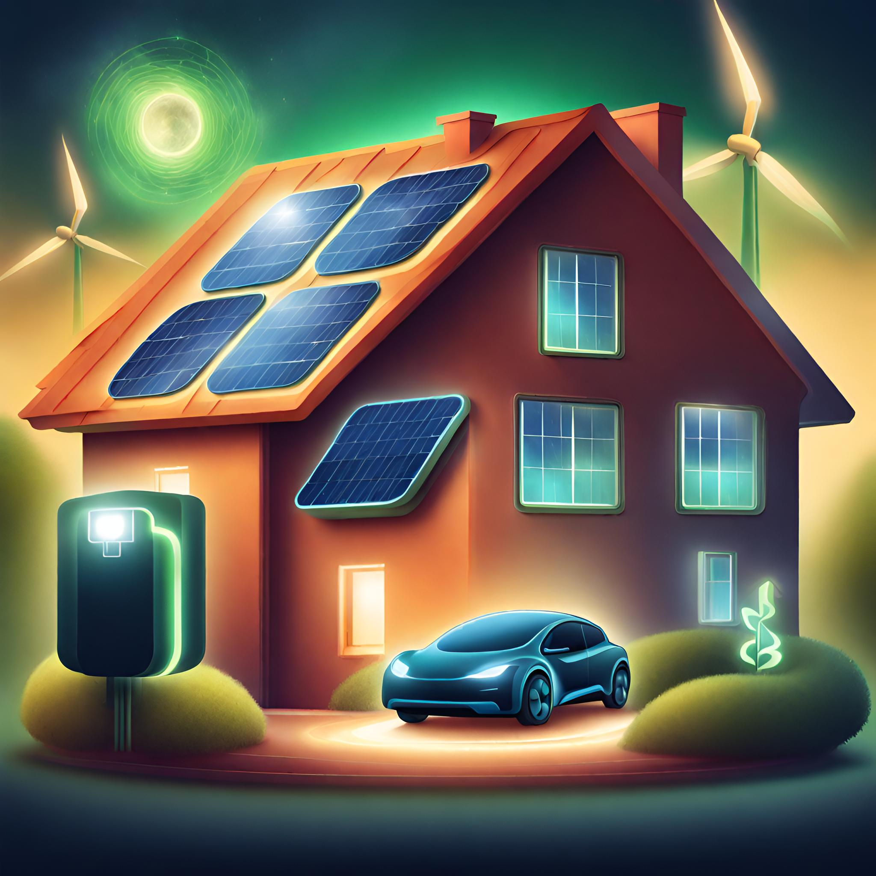
Python Installation on an NTU Laptop using Software Hub
Generated by AI with Canva
Python Refresher for Sustainable Energy Management Module

Slide 12
Getting Started with Python
Python Versions and Releases🖥️
The first step toward Python programming is Python installation for installation we need to know which version to install.
Python has 2 versions Python3 and Python2. Python2 is not supported anymore and is a bit different from Python3 in some syntaxes and Python3 include a wide range of libraries so for integrity during the course we use Python3.
You can see the latest Python releases inside NTU software Hub.
Python Refresher for Sustainable Energy Management Module
12

Slide 13

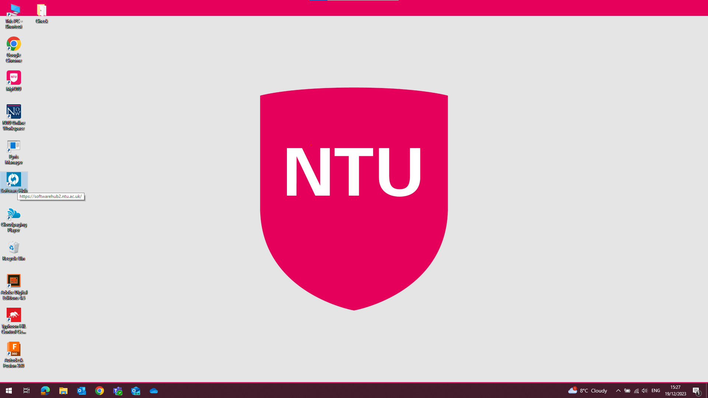
Getting Started with Python
Python Installation on an NTU Laptop Using Software Hub🖥️
Installing Python on Mac, Windows, and Linux involves slightly different steps due to the variations in operating systems. Below are the general instructions for Windows:
Installing Python on Windows:
Download Python from Software Hub:
Click on Software Hub icon
Or open Software Hub
at https://softwarehub2.ntu.ac.uk/
Login if you are not logged in before on
This laptop.
Python Refresher for Sustainable Energy Management Module
13

Slide 14
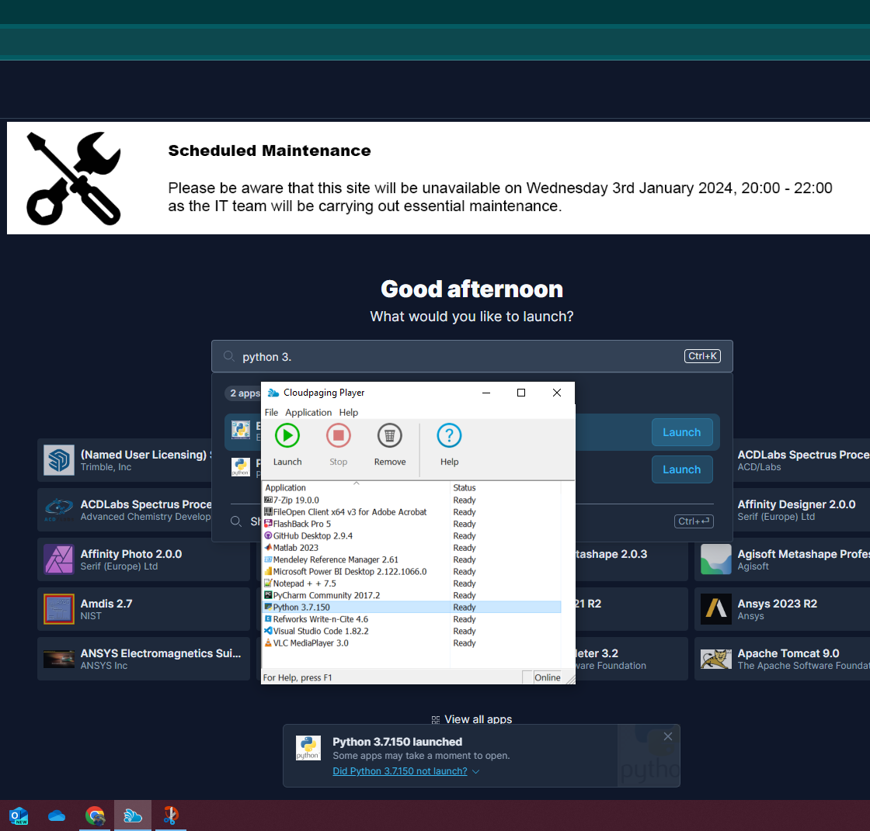
Getting Started with Python
Python Installation on an NTU Laptop Using Software Hub🖥️
Add Python to Cloudpaging Player:
Type Python 3. inside software hub search bar
and click on the latest Python version appeared there.
For integrity during course, we use Python 3.12.
Buy clicking on Launch bottom Python will be added
To the Cloudpaging to run.
Python Refresher for Sustainable Energy Management Module
14

Slide 15
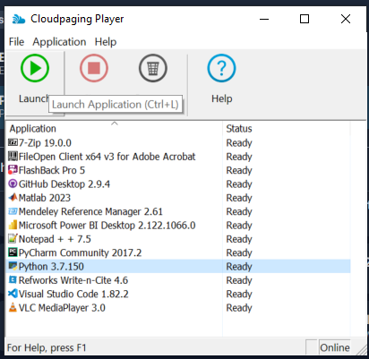
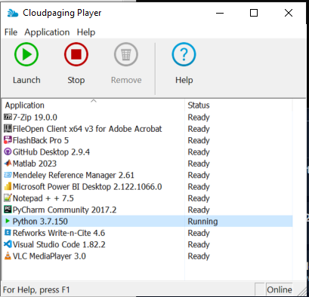
Section 2: Getting Started with Python
Python Installation on an NTU Laptop Using Software Hub🖥️
Run Python on Cloudpaging Player:
Click on Python and launch to launch python on your Laptop.
By Clicking on Launch Python going to Running state and is ready to use.
Two different black and white pages would be opened at this time shows you done your job correctly.
Python Refresher for Sustainable Energy Management Module
15

Slide 16


Python and Jupyter Installation on an NTU Laptop📽️Video Tutorial (Windows)
Link to access video:
⚠️ Python and Jupyter Installation 📽️Video Tutorial (Windows)
We're excited to share that we've created a video tutorial exclusively for installing Python and Jupyter on an NTU laptop and on Windows OS.
This video simplifies the installation process, ensuring a smooth setup for Python beginners.
Check it out in the Now Materials for step-by-step guidance and tips on using Python effortlessly. Happy coding!😉🧑‍💻
Python Refresher for Sustainable Energy Management Module
16

Slide 17
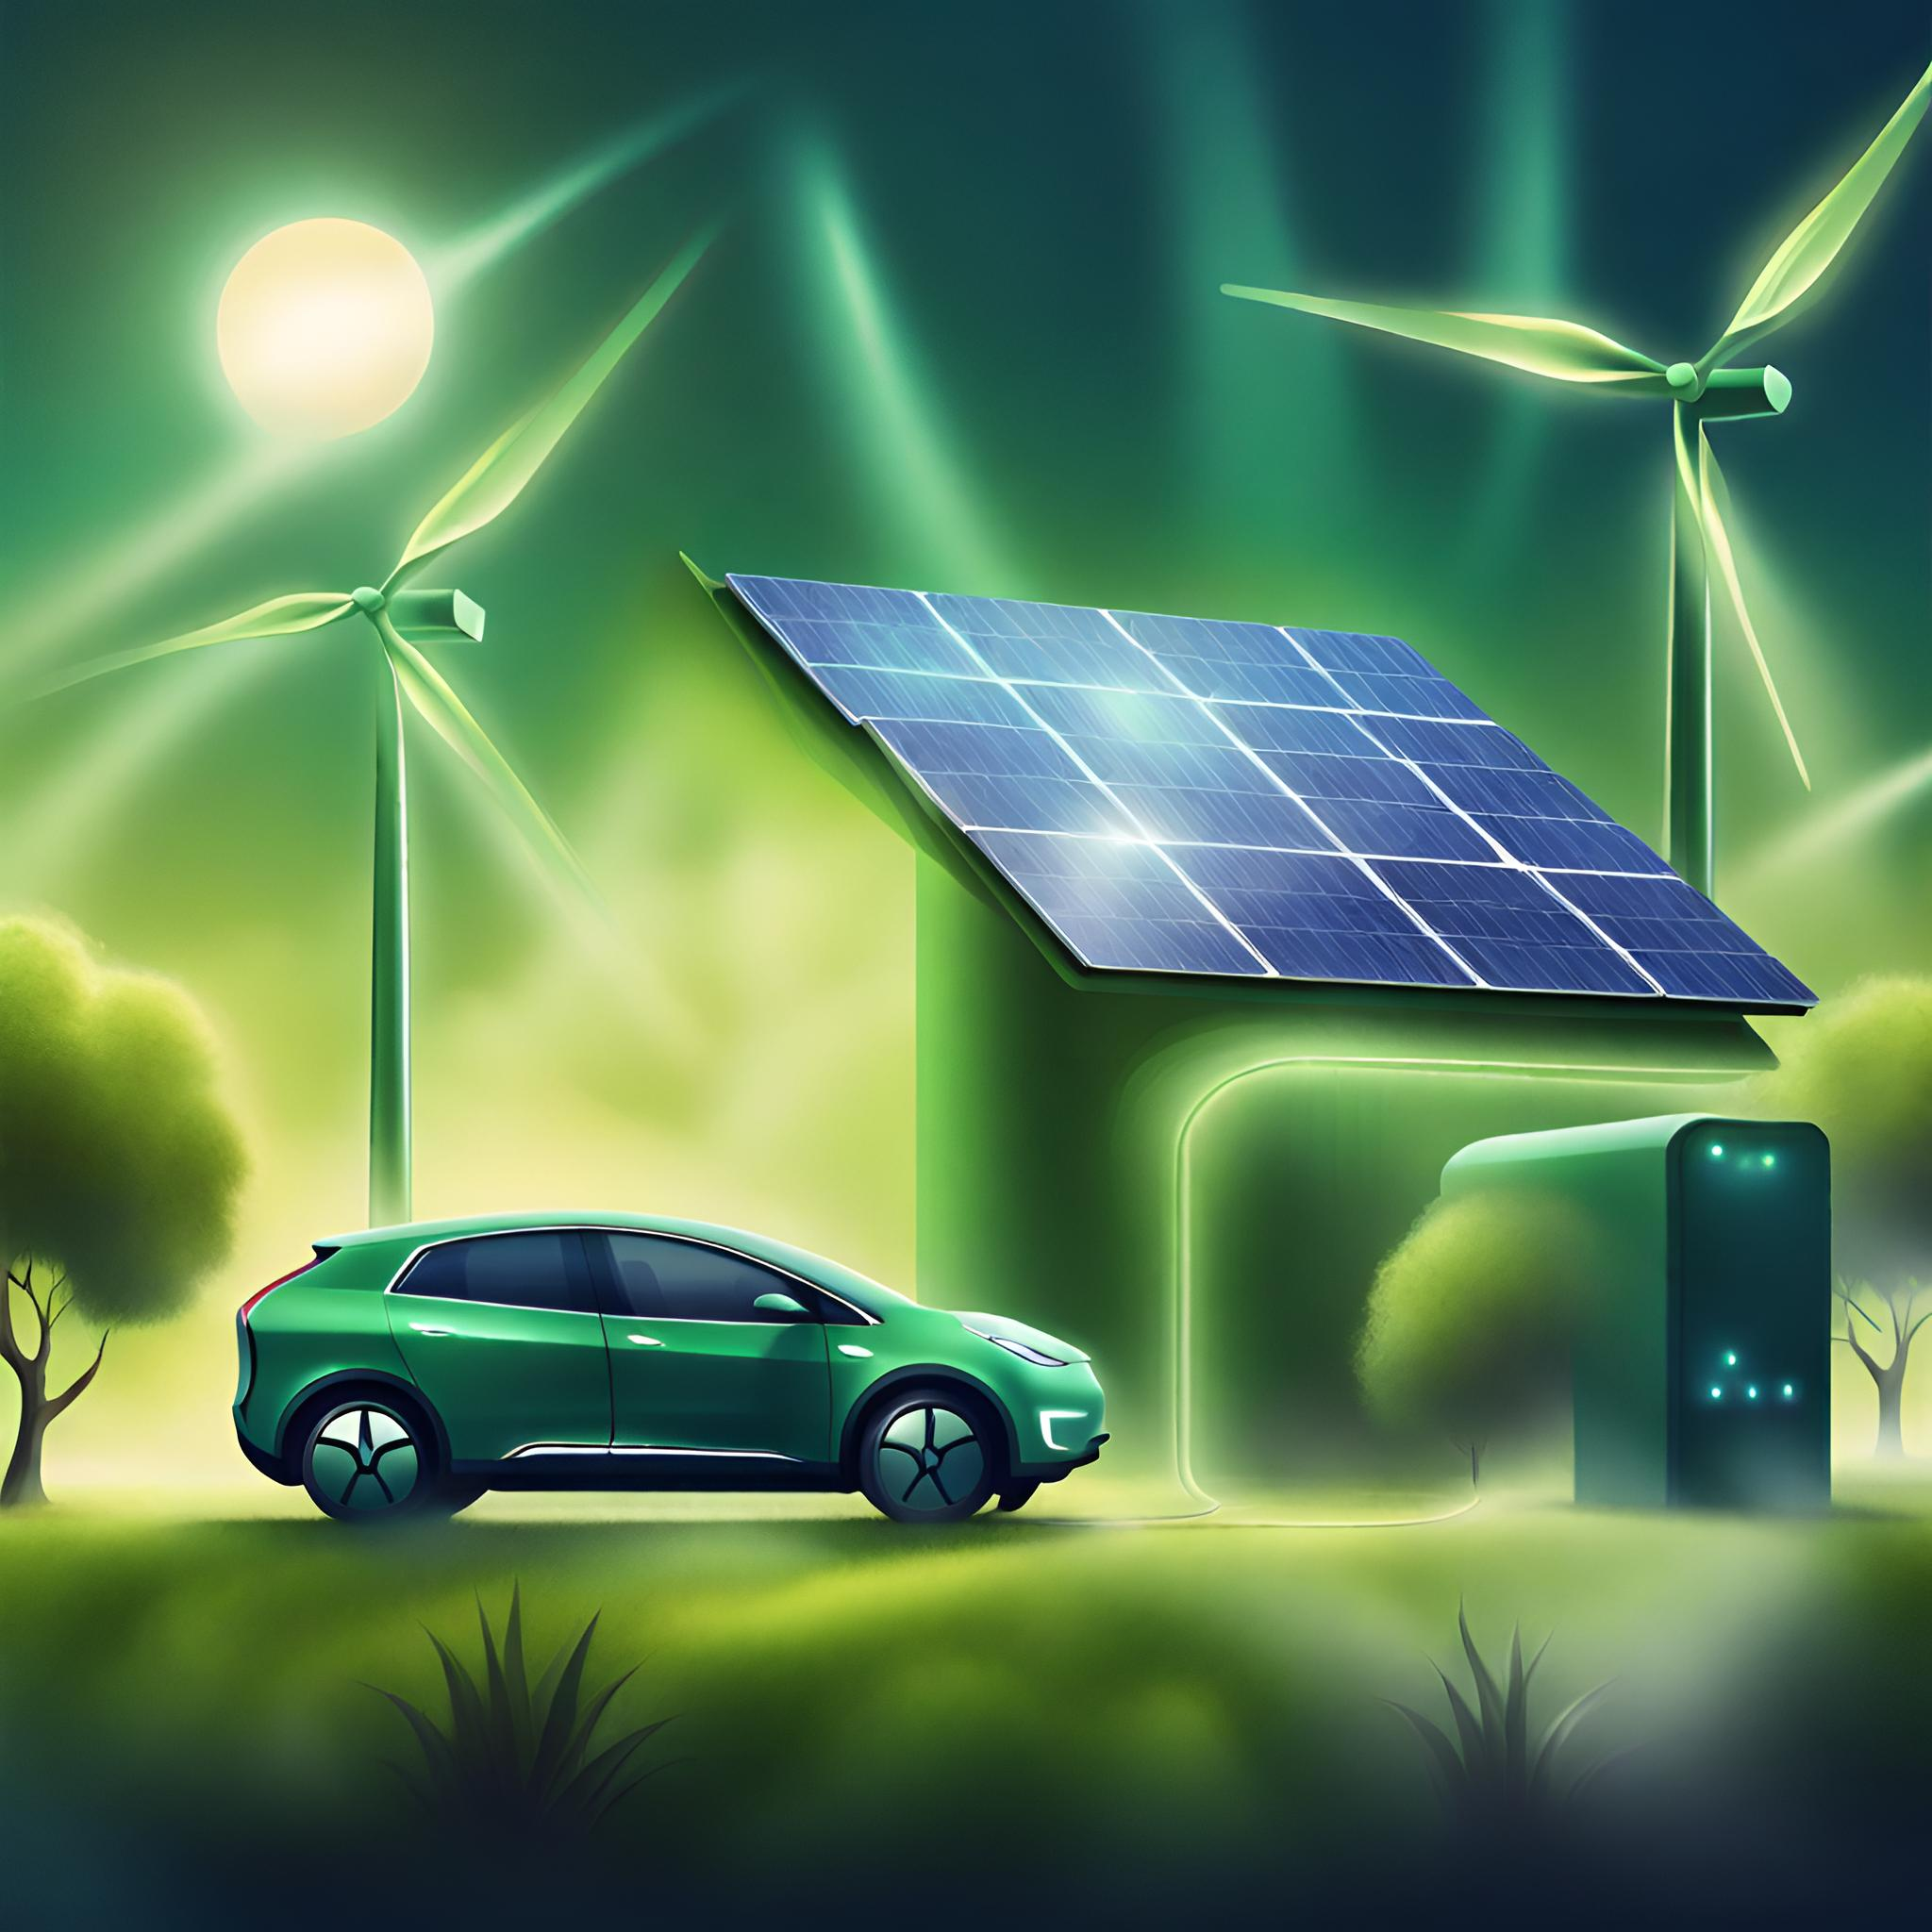
Python Installation on Your Own Laptop
Generated by AI with Canva
Python Refresher for Sustainable Energy Management Module

Slide 18
Section 2: Getting Started with Python
Python Versions and Releases🖥️
The first step toward Python programming is Python installation for installation we need to know which version to install.
Python has 2 versions Python3 and Python2. Python2 is not supported anymore and is a bit different from Python3 in some syntaxes and Python3 include a wide range of libraries so for integrity during the course we use Python3.
You can see the latest Python3 releases inside the Python website in the download section:
https://www.python.org/downloads/
Python Refresher for Sustainable Energy Management Module
18

Slide 19
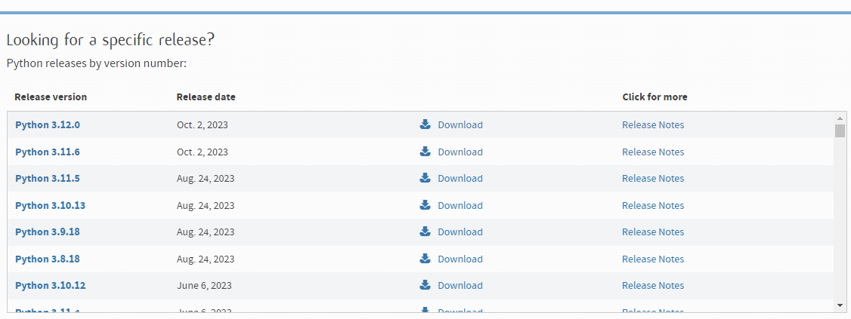
Getting Started with Python
Python Versions and Releases🖥️
As you can see inside the website there are many Python versions here the latest one is 3.12 we recommend using the latest release because normally the last release has a wide range of functionalities and improvements.
At this time the latest one is 3.12 and we use Python 3.12 during the course and recommend you use this version.
Python Programming For Sustainable Energy Management
19

Slide 20
Getting Started with Python
Python Installation🖥️
Installing Python on Mac, Windows, and Linux involves slightly different steps due to the variations in operating systems. Below are the general instructions for each:
Installing Python on Windows:
Download Python:
Visit the official Python website: Python Downloads.
Click on the "Downloads" tab, and select the latest version of Python for Windows(3.12).
Run Installer:
Once the installer is downloaded, run the executable file (it will be named something like python-3.x.x.exe).
Check the box that says "Add Python to PATH" during the installation.
Installation Wizard:
Follow the instructions in the Python Installation Wizard.
Verify Installation:
Open a command prompt or PowerShell or CMD and type `python --version` or `python –V` to verify that Python is installed. In some cases, if you have another Python installation you have to
Python Programming For Sustainable Energy Management
20

Slide 21

Getting Started with Python
Python Installation🖥️
Installing Python on macOS:
Download Python:
Visit the official Python website: Python Downloads.
Click on the "Downloads" tab, and select the latest version of Python for macOS.
Run Installer:
Once the installer is downloaded, run the package file (it will be named something like python-3.x.x-macosx10.x.pkg).
Installation Wizard:
Follow the instructions in the Python Installation Wizard.
Verify Installation:
Open the Terminal and type ‘python3 –version’ to verify that Python is installed.
Python Programming For Sustainable Energy Management
21

Slide 22
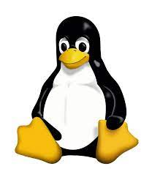
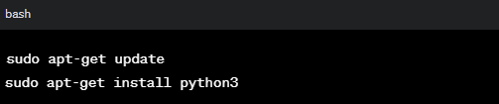
Getting Started with Python
Python Installation🖥️
Installing Python on Linux:
Check Python Version:
Many Linux distributions come with Python pre-installed.
Open a terminal and type `python3 –version` or `python –version` to check the version.
Install Python:
If Python is not installed, you can use your package manager to install it. For example, on Ubuntu, you can use:
Verify Installation:
Type `python3 –version` or `python –version` to verify the installation.
⚡Do not type` inside terminal just python3 –version !
Python Programming For Sustainable Energy Management
22

Slide 23

Python and Jupyter Installation on your own Laptop📽️Video Tutorial (Windows)
Link to access video:
⚠️ Python and Jupyter Installation 📽️Video Tutorial (Windows)
We're excited to share that we've created a video tutorial exclusively for installing Python and Jupyteron on your own laptop and on Windows OS.
This video simplifies the installation process, ensuring a smooth setup for Python beginners.
Check it out in the Now Materials for step-by-step guidance and tips on using Python effortlessly. Happy coding!😉🧑‍💻
Python Refresher for Sustainable Energy Management Module
23

Slide 24
Jupyter Notebook Installation
Generated by AI with Canva
Python Refresher for Sustainable Energy Management Module

Slide 25

Getting Started with Python
How to use the installed Python⁉️:
Python is based on scripts you can use your computer command line to write down scripts and see the outputs, as it may be hard to deal with the command line interface on Windows or console on Linux, there are many advanced IDEs developed for using Python, one of the easy use interfaces for using python is Jupiter notebook, Jupiter notebook give you a web interface for writing your codes in web browser environment and we use Jupiter during our Python Programming sessions. In the next slides we give you the instructions for installing Jupyter Notebook and how to run your first Python code🐍⌨️💻
Let’s start to install Jupyter Notebook
Python Refresher for Sustainable Energy Management Module
25

Slide 26
Getting Started with Python
Jupyter Notebook Installation🖥️
Installing Jupyter on Mac, Windows, and Linux involves slightly different steps due to the variations in operating systems. Below are the general instructions for each:
Installing Jupiter Notebook on Windows:
Open Command Prompt:
Push Windows+R button and type cmd and click OK or (you can search for "cmd" in the Start menu and Run command prompt application).
Install Jupyter using pip:
In the Command Prompt, type the following command and press Enter to install Jupyter using the Python package manager, pip:
`pip install jupyter`
Verify Installation:
After the installation is complete, you can verify it by typing:
`jupyter notebook`
This command should open a new tab in your default web browser with the Jupyter Notebook interface.
Python Refresher for Sustainable Energy Management Module
26

Slide 27
Getting Started with Python
Jupyter Notebook Installation🖥️
Installing Jupyter on Mac, Windows, and Linux involves slightly different steps due to the variations in operating systems. Below are the general instructions for each:
Installing Jupiter Notebook on Windows:
Create a Jupyter Notebook:
In the Jupyter Notebook interface, you can create a new notebook by clicking on "New" and selecting "Python 3" (or any other available kernel).
Python Refresher for Sustainable Energy Management Module
27

Slide 28
Learning Resources
Generated by AI with Canva
Python Refresher for Sustainable Energy Management Module

Slide 29



Getting Started with Python
🐍Python Learning Resources
There are numerous online resources available for learning Python, like YouTube and … addressing your questions regarding Python syntax. Here are some of them:
- Python official website documentation: https://docs.python.org/3/tutorial/index.html
- Python cheatsheet website: https://www.pythoncheatsheet.org/cheatsheet/
- Today AI is so hot🔥, many of the pictures you saw in this slide was created by AI, so you can use Generative AI like ChatGPT and Google Bard:
Chatgpt: https://chat.openai.com/
Google Bard: https://bard.google.com/chat
Always consider NTU policies when using AI. You can find Dos and Don’ts in: https://www.ntu.ac.uk/studenthub/news/2023/12/artificial-intelligence-@-ntu
Python Refresher for Sustainable Energy Management Module
29

Slide 30
Python Basics
Generated by AI with Canva
Python Refresher for Sustainable Energy Management Module

Slide 31

Python Basics
Link to access files on Now Learning Room:
🐍 Python Basics Refresher
In this section, we delve into Python basics by presenting various examples.
We provide a set of IPython files created for use within the class, and together, we learn how to code in Python, line by line. Additionally, we review basic Python syntax for students who have prior experience with the language.
The primary objective of this class is not solely to teach Python itself; instead, we aim to review Python as a valuable tool for working with diverse datasets in sustainable energy management.
We demonstrate how Python can be effortlessly utilized to solve problems and showcase its ease of use in practical applications.
Python Refresher for Sustainable Energy Management Module
31

Slide 32

Link to access Jupyter notebook files and Slides on Github:
32

